Slide 1
Hypothermia Hyperthermia Starvation and Neglect
Dr. Nirmala Perera
2016

Slide 2
Objectives
Identify causes for hypothermia and hyperthermia
Identify features of hypothermia and hyperthermia
Describe features of starvation and neglect
Identify circumstances of death

Slide 3
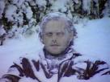
Hypothermia
Body temperature is usually maintained near a constant level of 36.5–37.5 °C (97.7–99.5 °F) through thermoregulation.
Body core temperature below 35 °C (95 °F) causes heat loss from the body than heat production.

Slide 4
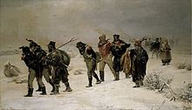
Response to hypothermia
Efforts to increase body temperature involve shivering, increased voluntary activity, and putting on warmer clothing.
The armies of Napoleon retreat from
Russia in 1812.
They faced hypothermia.

Slide 5
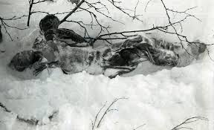
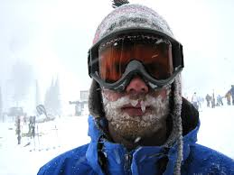
Factors involved in hypothermia
Low environmental temperature
Air temperature < 10 ⁰ C
Age and physique
The elderly and the young

Slide 6
Factors involved in hypothermia
Lack of subcutaneous fat
Poor thyroid function
Cerebral dysfunction

Slide 7
Circumstances
1. Exposure to cold
Dry - cold hypothermia
Immersion hypothermia
2.Exposure to cold with under the influence of alcohol or drugs
3. Exposure to cold with natural diseases
4. Therapeutic hypothermia

Slide 8
Diagnosis of hypothermia
History of exposure
The victim - elderly person, mountain climbers ,divers
Past history –
CVA
Hypothyroidism
Alcoholism
Diabetes

Slide 9
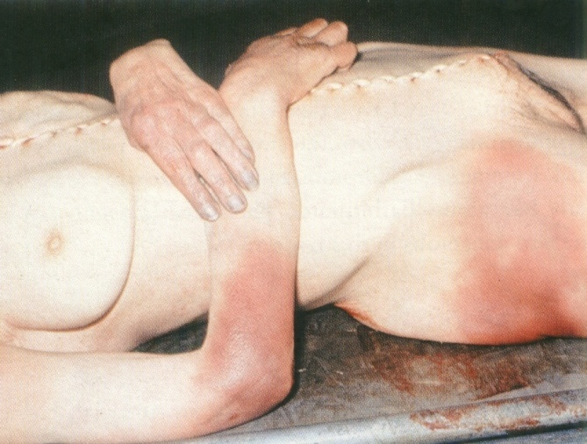
Diagnosis of hypothermia
Patches of pink to brownish - pink on the extensor surfaces and large joints
Cyanosed extremities

Slide 10
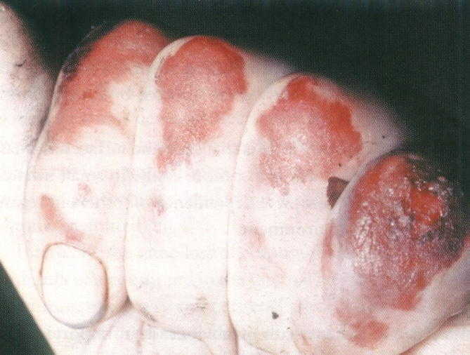
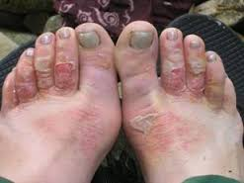
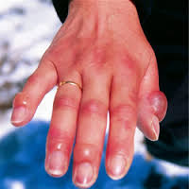
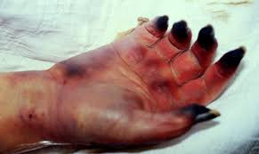
Diagnosis of hypothermia
Frost bites- blisters and gangrene
Reddish flat nodule in the skin

Slide 11
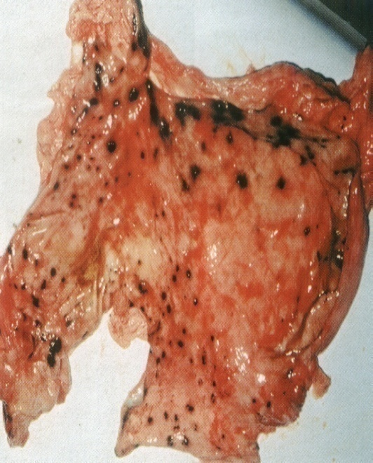
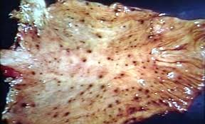
Diagnosis of hypothermia
Acute pulmonary oedema
Acute gastric erosions
Acute pancreatitis
Peri-vascular haemorrhages in
the wall of third ventricle
Micro-infarcts in organs

Slide 12
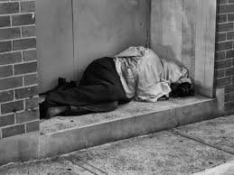
“Hide and die syndrome” or Terminal burrowing
The afflicted will enter small, enclosed spaces, such as underneath beds or behind wardrobes.
It is often associated with paradoxical undressing.
Usually an old person, mostly in cases where temperature drops slowly.

Slide 13
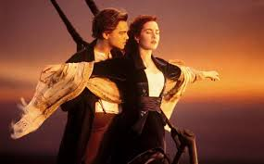
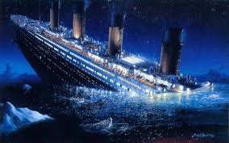
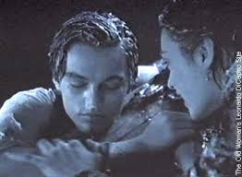
Cause of death in Hypothermia – Titanic deaths
Hypothermia: This was the cause of death of most of the people who landed alive in the ocean. (21-31⁰F @ North Atlantic ocean)

Slide 14
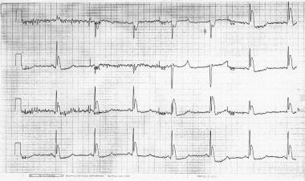
Mechanism and cause of death
Failure in thermoregulation
Decrease depolarization of cardiac muscles
CNS depression
Cessation of circulation preceded by arrhythmia
Osborne (J) waves (V3) in a patient with a rectal core temperature of 26.7°C (80.1°F)

Slide 15
Hyperthermia

Slide 16
Hyperthermia
Hyperthermia
Heat exhaustion
Heat Stroke

Slide 17
Heat exhaustion
Heat exhaustion –Prolonged exposure to hot conditions with increase sweating, loss of water and salt from the body
Eg: Exercise, sports

Slide 18
Heat exhaustion
Exposure to a hot environment normally results in the activation of heat loss mechanisms, and body temperature is maintained at normal levels.
This is an example of a negative-feedback mechanism.
In prolonged exposure to a hot environment can result in heat exhaustion.
The normal negative-feedback mechanisms for controlling body temperature are operating, but they are unable to maintain a normal body temperature.
Heavy sweating results in dehydration, decreased blood volume, decreased blood pressure, and increased heart rate.

Slide 19
Heat exhaustion -Symptoms
Mild dehydration
Co-temperature 100- 104 ⁰F
Profuse sweating
Thirst, nausea, vomiting
Muscular cramps
Confusion, giddiness
Faintishness
Collapse
Relieved by the replacement of salt and water.

Slide 20
Heat stroke
Heat stroke is a breakdown of the normal negative-feedback mechanisms of temperature regulation.
If the temperature of the hypothalamus becomes too high, it no longer functions appropriately.
Sweating stops, and the skin becomes dry and flushed.

Slide 21
Heat stroke -Symptoms
Dry skin
Body temperature is high-107-110 F
Delirium, thirst and photophobia
Confusion
Coma
Death

Slide 22
Circumstances
Abundant young child under the sun
Forced exercise
Exposure in a desert
Engine room
Prolong surgery without A/C

Slide 23
Diagnosis of hyperthermia-Clinical
History
Clinical features
Body temperature 40 to 43 C

Slide 24
Diagnosis of hyperthermia- Post mortem
History
Minimal Post Mortem changes
High rectal temperature
Rhabdomyolysis

Slide 25
Diagnosis of hyperthermia
Cerebral oedema
ARDS
Organ failure- Liver failure
DIC - micro-thrombi formation and coagulative necrosis

Slide 26
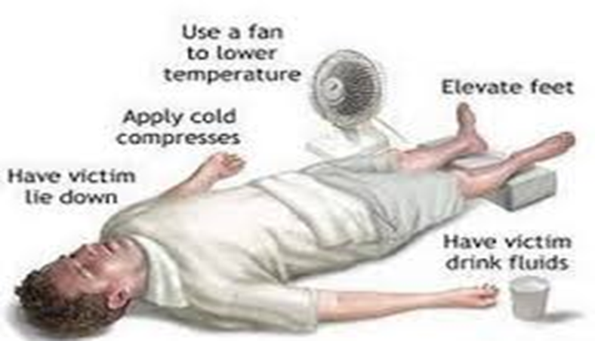
Prevention
Adequate fluid and Electrolytes replacement

Slide 27
Starvation and neglect
Severe form of malnutrition is considered as starvation.
When it is associated with neglect, then it is important in forensic.

Slide 28
Malnutrition
Substantial fat and muscle mass is broken down in malnutrition, in order to keep vital systems functioning.
Vitamin deficiency is a common result of starvation, often leading to anemia, beriberi, pellagra, and scurvy.
These diseases collectively cause diarrhoea, skin rashes, oedema, and heart failure.
Individuals are often irritable and lethargic as a result.

Slide 29
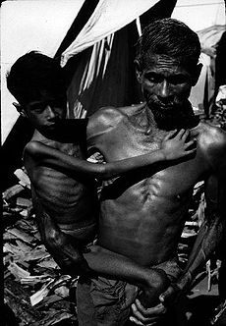
Types of malnutrition
Marasmus
Marasmus is a form of severe malnutrition characterized by energy deficiency.
A child with marasmus looks emaciated.
Body weight is reduced to less than 60% of the normal (expected) body weight for the age.

Slide 30
Features of Marasmus
Shrunken, wasted appearance,
loss of muscle mass and subcutaneous fat mass
Buttocks and upper limb muscle groups are usually more affected than others.
unusual body temperature (hypothermia, pyrexia),
Dehydration
hypovolemic shock (weak radial pulse, cold extremities, decreased consciousness),
evidence of infection

Slide 31
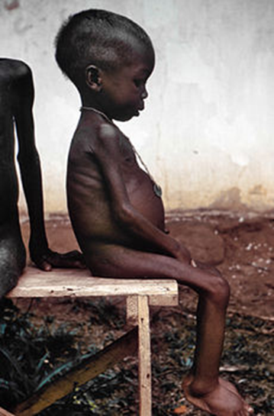
Types of malnutrition
Kwashiorkor
kwashiorkor is protein deficiency with adequate energy intake whereas marasmus is inadequate energy intake in all forms, including protein.
Protein wasting in kwashiorkor may lead to oedema
Ascites
Pleural effusion

Slide 32
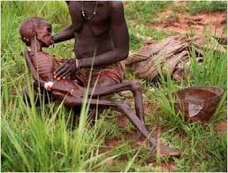
Starvation
Starvation
Starvation is a severe deficiency in caloric energy intake needed to maintain human life. It is the most extreme form of malnutrition.
In humans, prolonged starvation can cause permanent organ damage and eventually, death.

Slide 33
Incidences
Criminal ( neglected old people and children)
Natural ( CA oesophagus, CA stomach)
Accidental (mine collapse, ship wrecks)
Suicidal ( Hungers strike, voluntary fast)

Slide 34
Starvation and neglect
General process
40% body weight lose – Life threatening
Deprivation of water - Kill in abut 10 days
Total lack of food for 50-60 days – likely to cause death
Children and elderly are at risk because they are dependent

Slide 35
Death due to starvation and neglect
History
Circumstances
During autopsy attention should be given to the cause for the starvation such as presence of natural illness or whether there is deliberate withholding of food or neglect.
Exclude physical abuse
External examination
Internal examination
Pre autopsy x ray

Slide 36
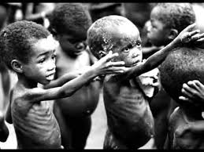
Post mortem findings
External
Infants – length and weight is reduced
General emaciation (Jaw and cheek are prominent, Ribs prominent , scaphoid abdomen, thin limbs)
Eyes sunken
Head may appear large

Slide 37
Post mortem findings
External
Skin is translucent, pale
Skin dry and wrinkled due to dehydration
Pressure sores
Dry brittle hair
Skin ulcers

Slide 38
Post mortem findings
Internal
Absence of subcutaneous fat
Muscle atrophy
Organ atrophy
Absent of internal fat (mesentery, epicardium)
Contracted empty stomach with bile stains
Intestinal atrophy
Hard stool
Distended gall bladder

Slide 39
Opinion
Starvation as a cause of death or contributory factor
Contribution of natural illness for starvation
Contribution of neglect

Slide 40
Summary
Hypothermia
Hyperthermia
Starvation and neglect

